Slide 1
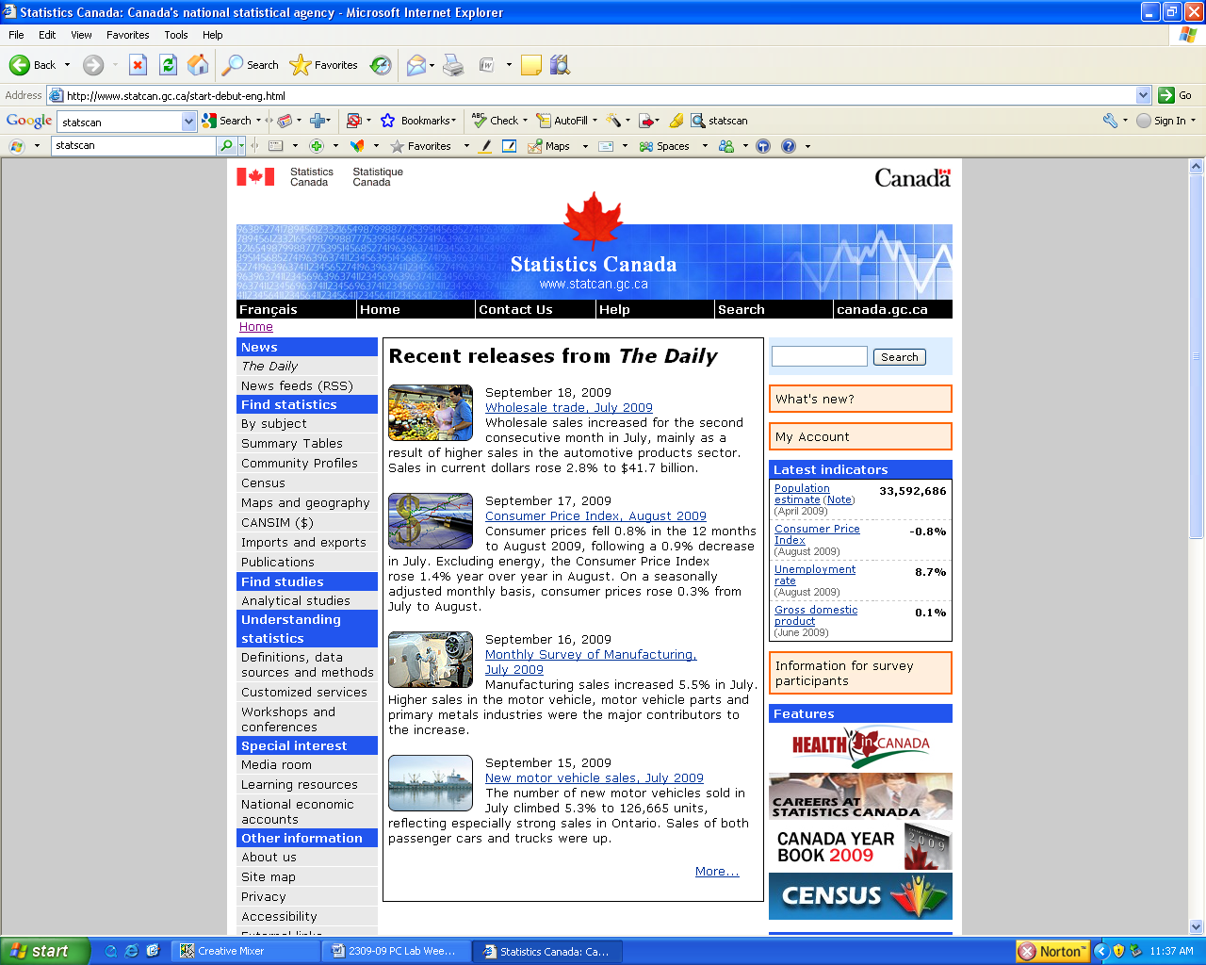
Statistics Canada and the Use of Longitudinal Data
MKTG 2341-09 PC Lab Week 3

Slide 2
Statistics Canada
produces statistics that help Canadians better understand their country—its population, resources, economy, society and culture
“Objective statistical information is vital to an open and democratic society. It provides a solid foundation for informed decisions by elected representatives, businesses, unions and non-profit organizations, as well as individual Canadians.”

Slide 3
Statistics Canada
Statistics Canada conducts a Census every five years (in years ending in a ‘1’ and a ‘6’, such as 2001 and 2006)
In addition to the Census, Statistics Canada conducts approximately 350 active surveys on virtually all aspects of Canadian life.

Slide 4
Statistics Canada
It can take years for Statistics Canada to compile, interpret and release all of the information collected from the Census.
Their website is a goldmine of information.
Information is available in a variety of different formats, including data tables, charts and graphs, reports, maps, and so on.
Let’s look at some of these…

Slide 5
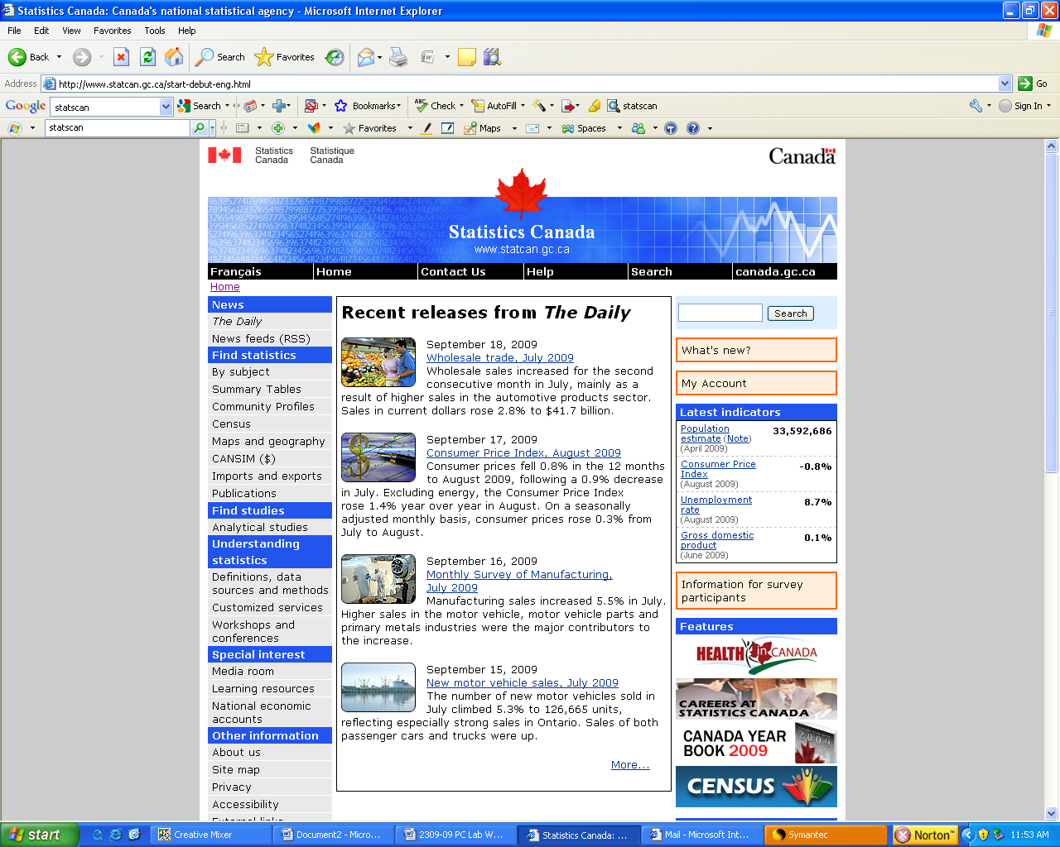
Here is where you will find a wide variety of statistical resources, searchable by subject, community, Census, and so on.

Slide 6
Let’s look at data by subject. Click on this link.

Slide 7
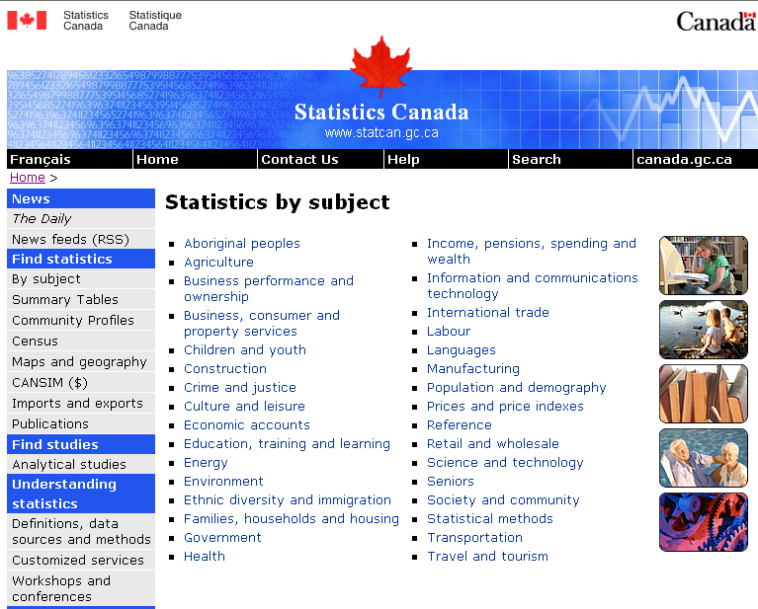
Just choose a subject that you are interested in and click on its link.
Try families, households and housing.

Slide 8
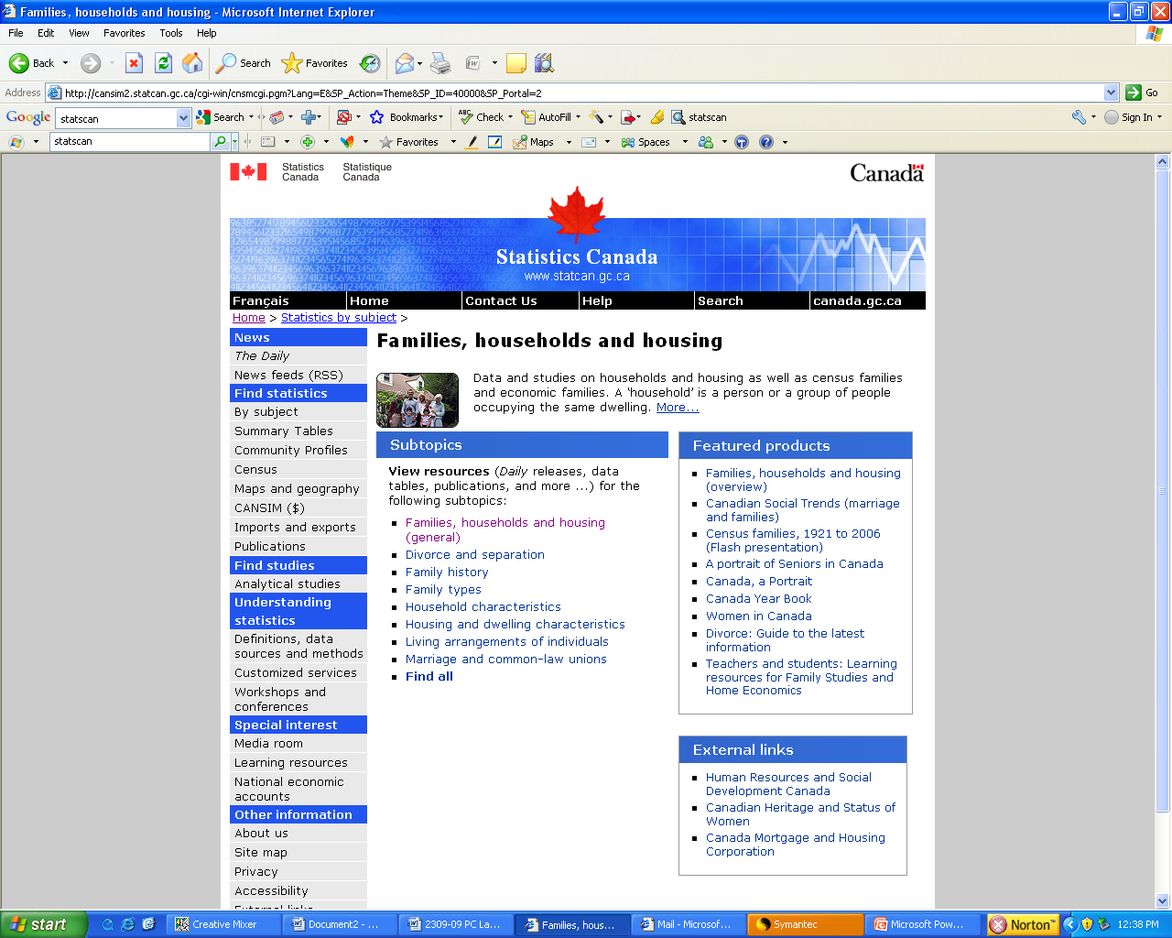
But there are a lot of useful resources, focused on specific themes here.
And links to related resources here.
Much of what you want will be found here.

Slide 9
Now let’s look at the Summary Tables resource.

Slide 10
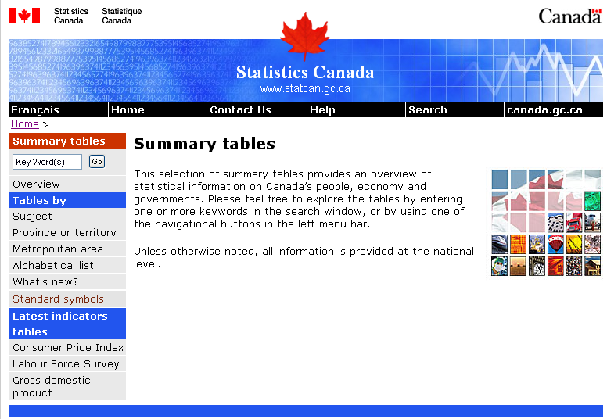
Choose tables by subject, province or territory, metropolitan area or alphabetically.

Slide 11
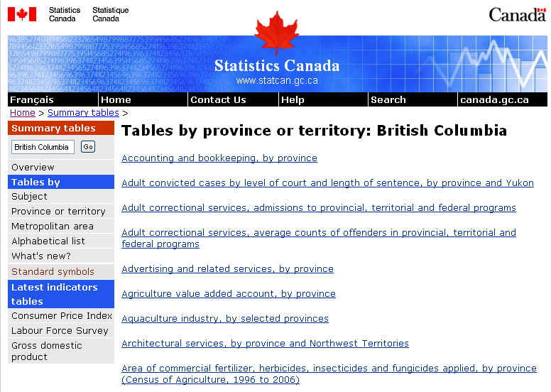
This is just the beginning of a list of hundreds of tables to choose from for BC.

Slide 12
Now let’s look at the Community Profiles resource.

Slide 13
Statistics Canada
Community Profiles are a fantastic resource for marketers.
They allow you to see at a glance what types of people live in the communities that you might be interested in marketing to.

Slide 14
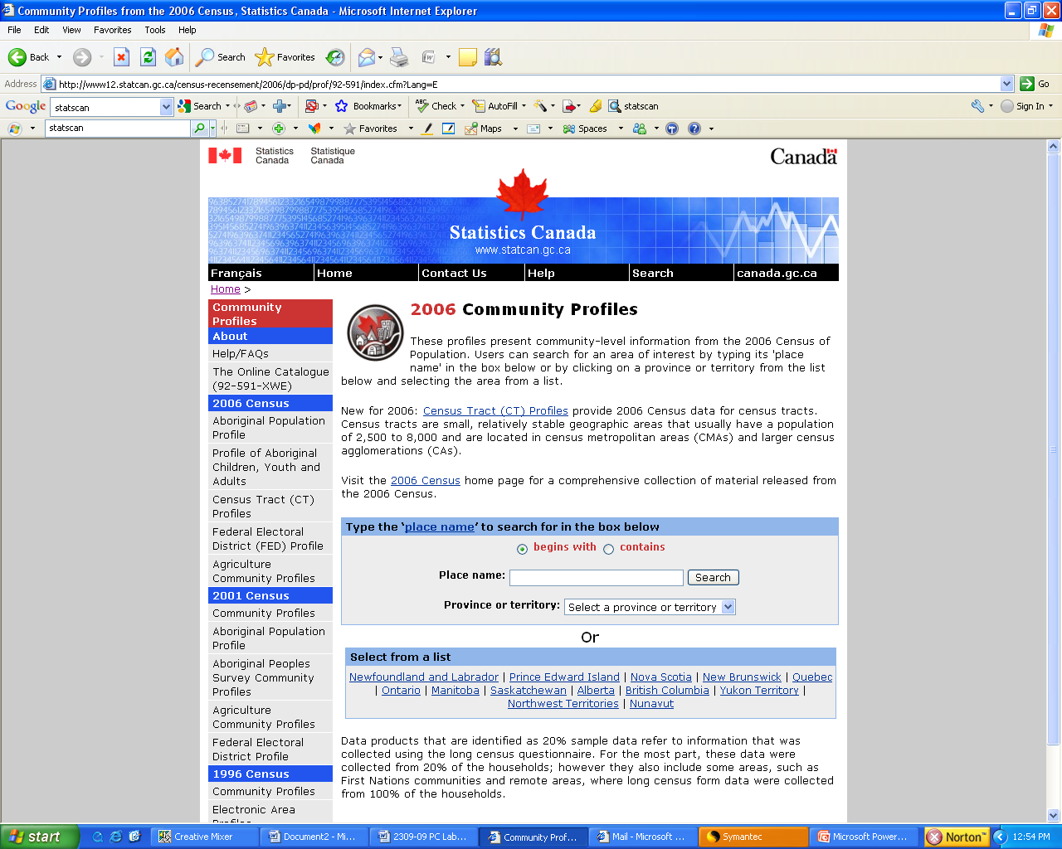
You can look at data by Census Tract, Federal Electoral Districts or Agricultural Communities.
Or specify a particular community or province/territory that you are interested in.

Slide 15
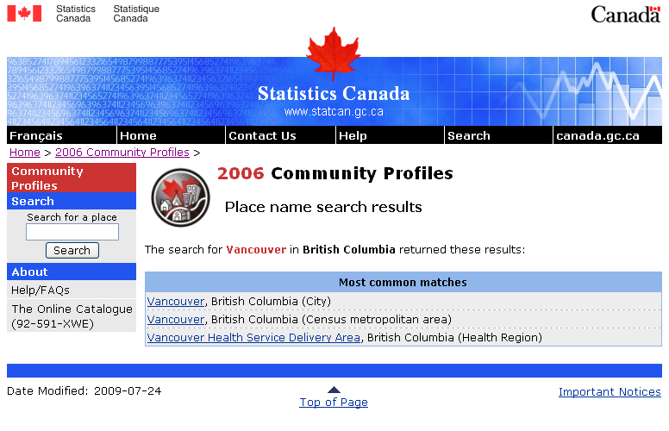
Here are some options to choose from in a search for data on Vancouver.

Slide 16
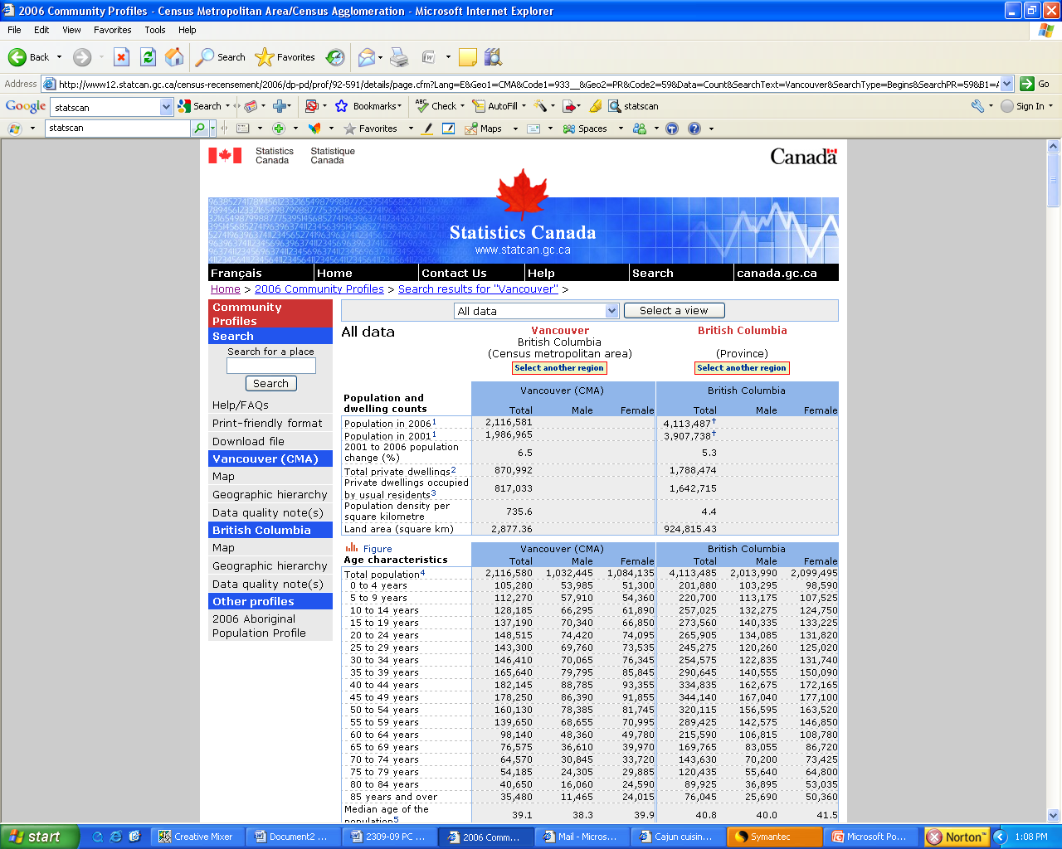
Here is demographic data for the Vancovuer CMA compared with data for BC as a whole.

Slide 17
Clicking on this link will provide you with a number of different mapping options.

Slide 18
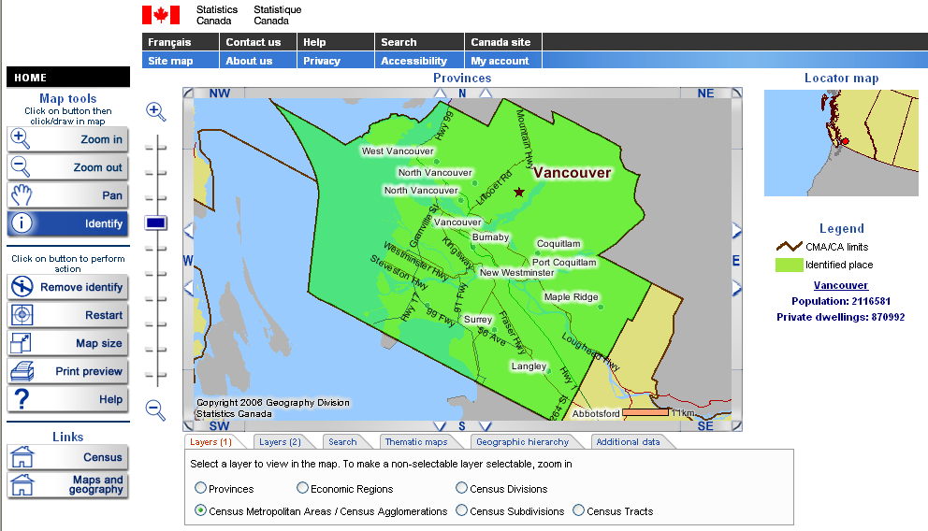
Here are your different mapping options.

Slide 19
Finally, there is a search function that you can use to search the entire website.

Slide 20
Statistics Canada
Now it’s your turn.
Open up the PC Lab Week 3 document on Share Out.
Use the four resources that you have just been shown (Search by Subject, Summary Table, Community Profile and the Search Function) to answer the questions.
When you are finished, submit on Share In.

